Slide 1


Wombo Combo (Preliminary Title)
Synchronize with your friends and combine spirits to unleash devastating wombo combos onto the enemy team.
A competitive game that focuses fully on teamwork and the satisfaction of managing to do well together.
A game that skips straight into the action, makes for quick and exciting rounds with a bunch of shouting and screaming.

Slide 2
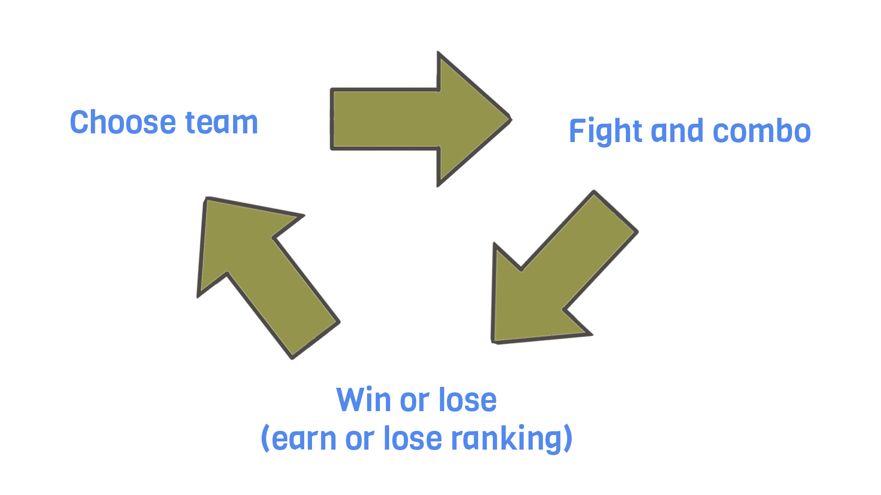

Slide 3
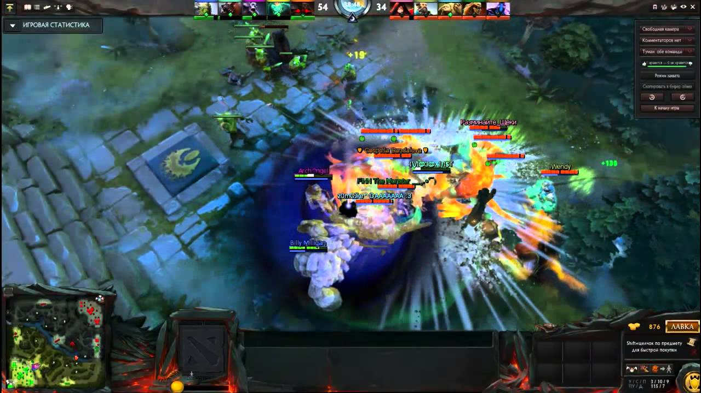
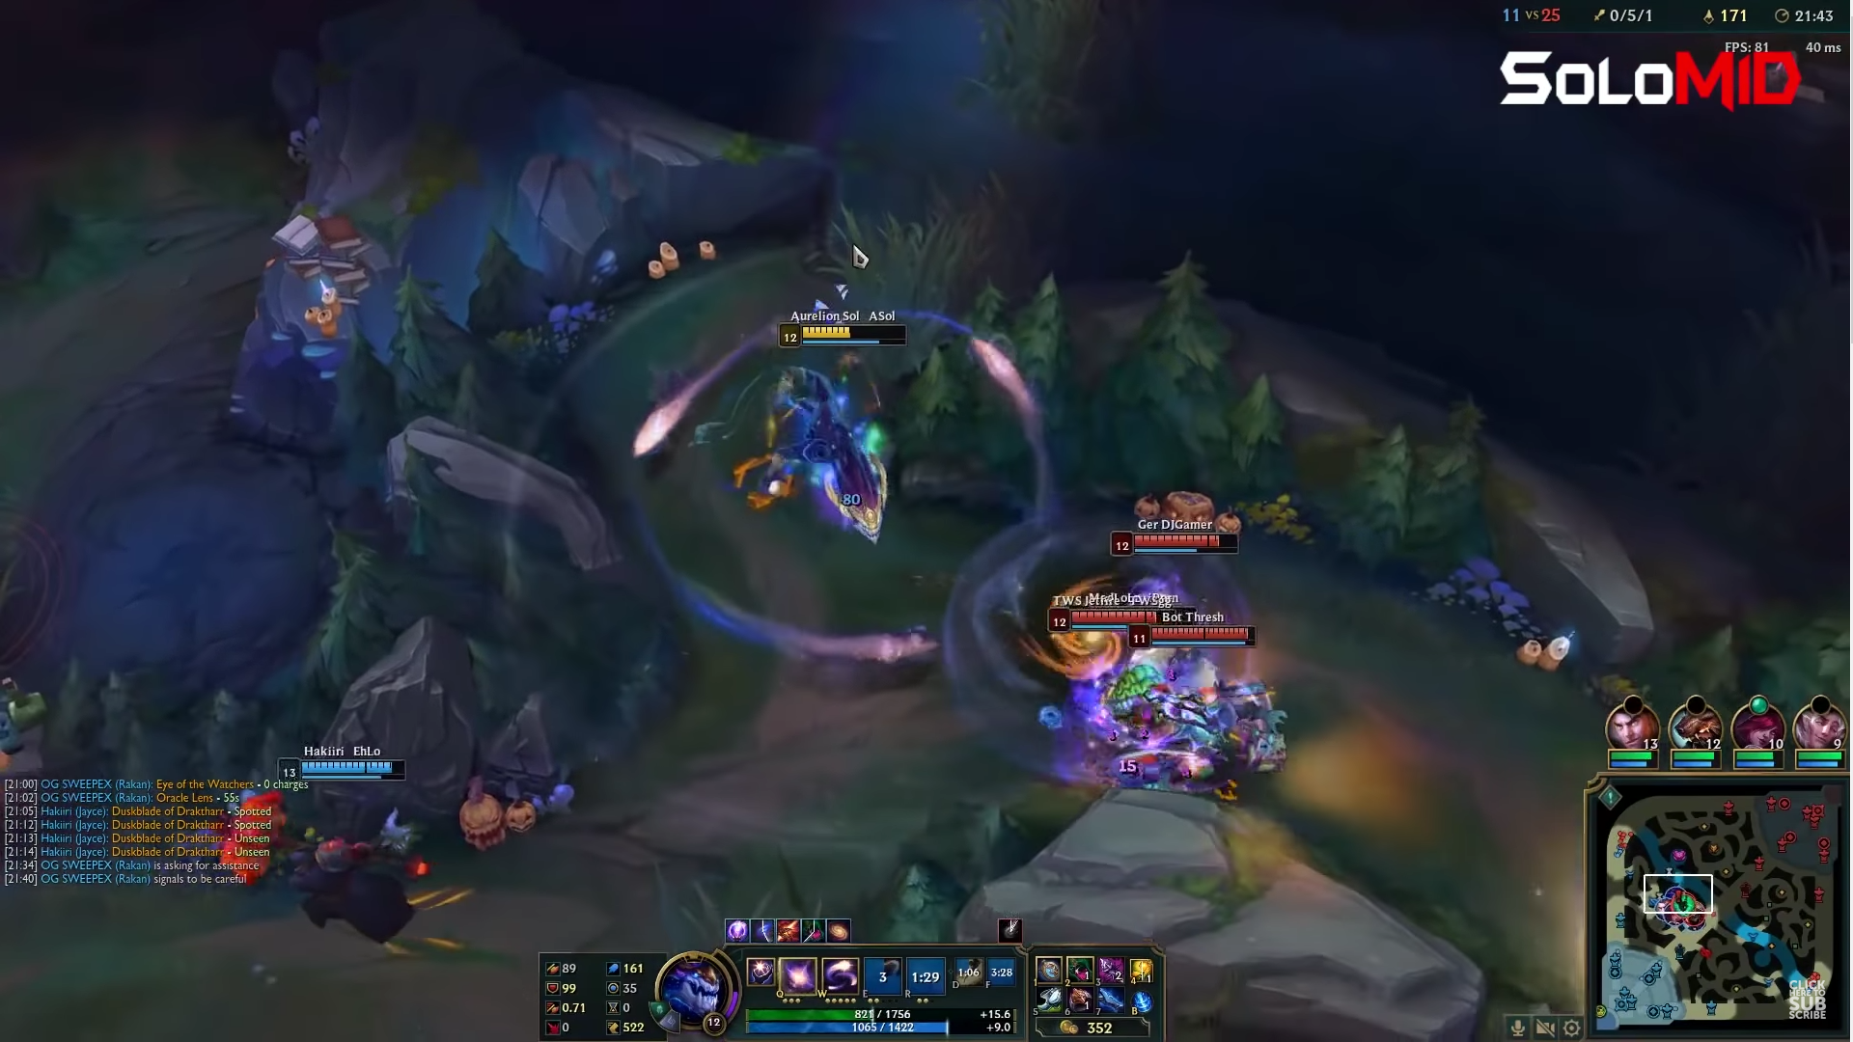
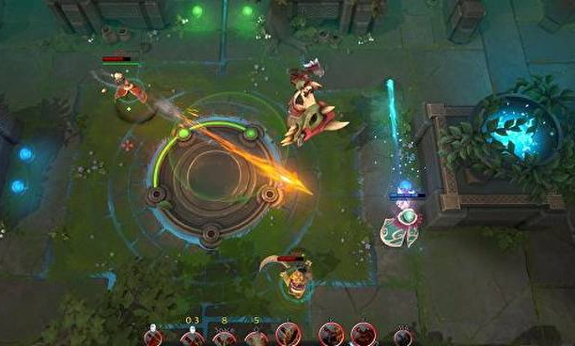
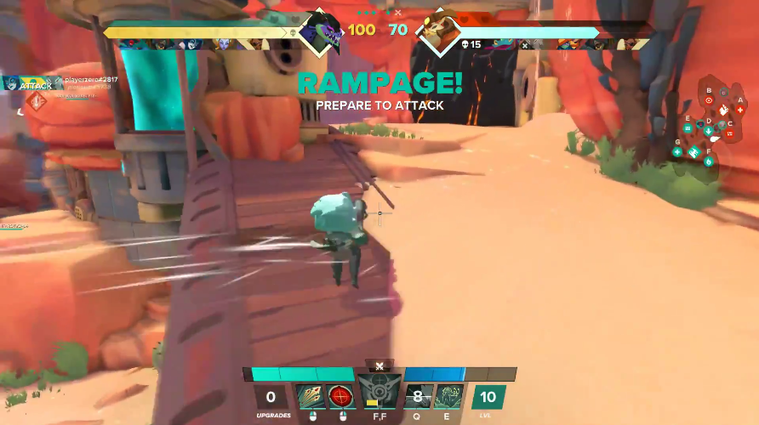
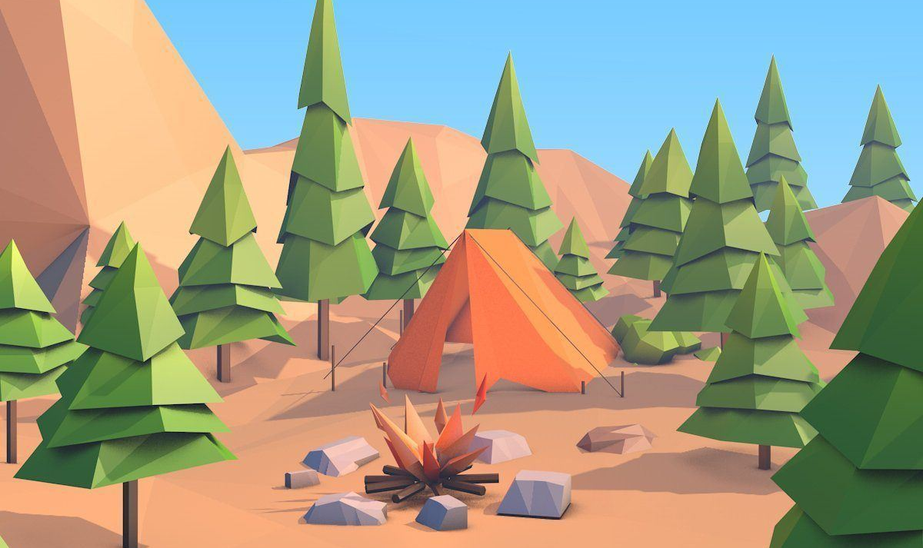
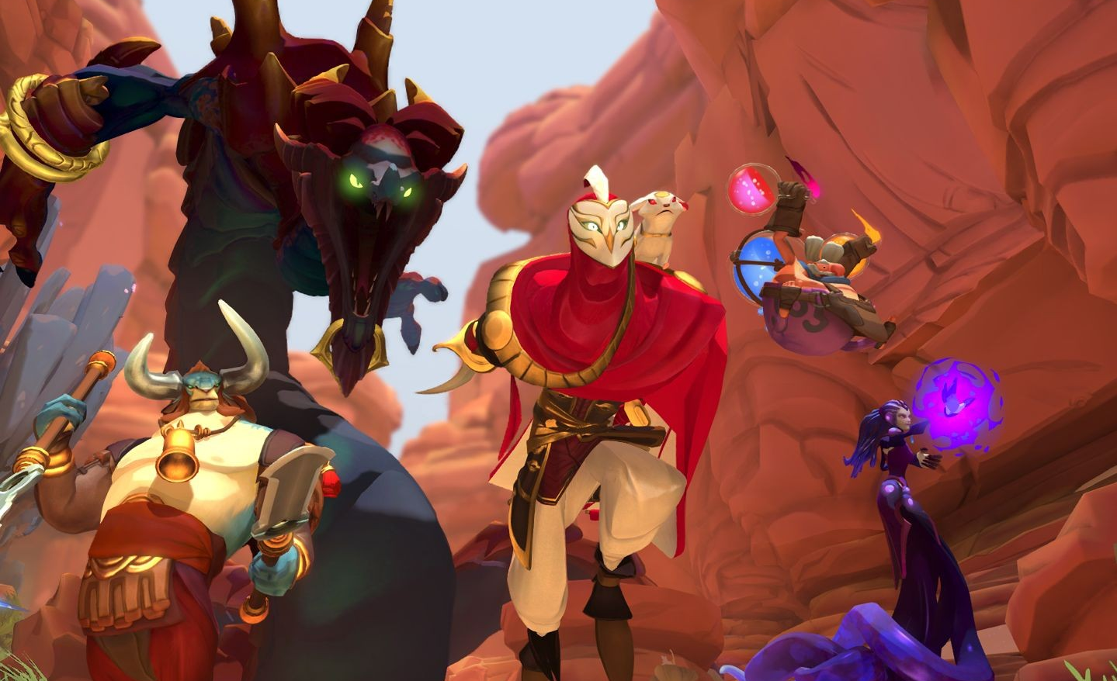
Moodboard

